Slide 1
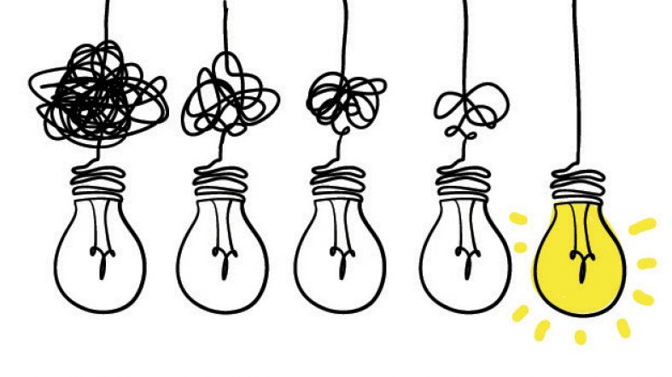
Chemicals Governance
Made Simple

Slide 2
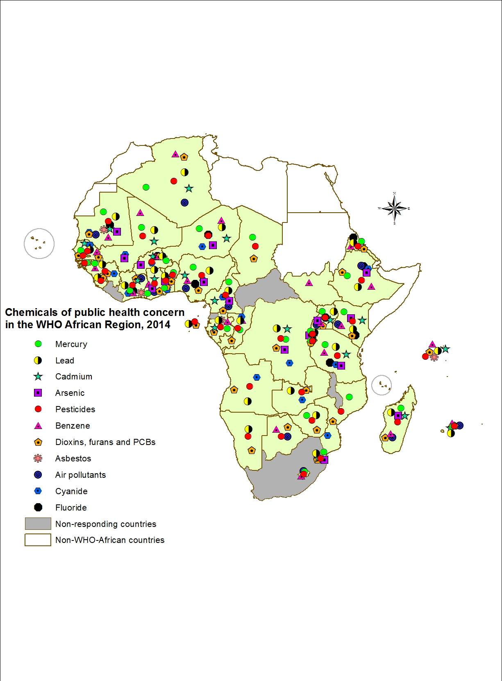
The Problem
Hazardous chemicals can negatively affect human health and the environment.
In this example from the African region, we can see how the impacts of certain chemicals can widely become a public health concern.
https://www.afro.who.int/publications/chemicals-public-health-concern-african-region-and-their-management-regional
Notes:
https://www.afro.who.int/publications/chemicals-public-health-concern-african-region-and-their-management-regional

Slide 3
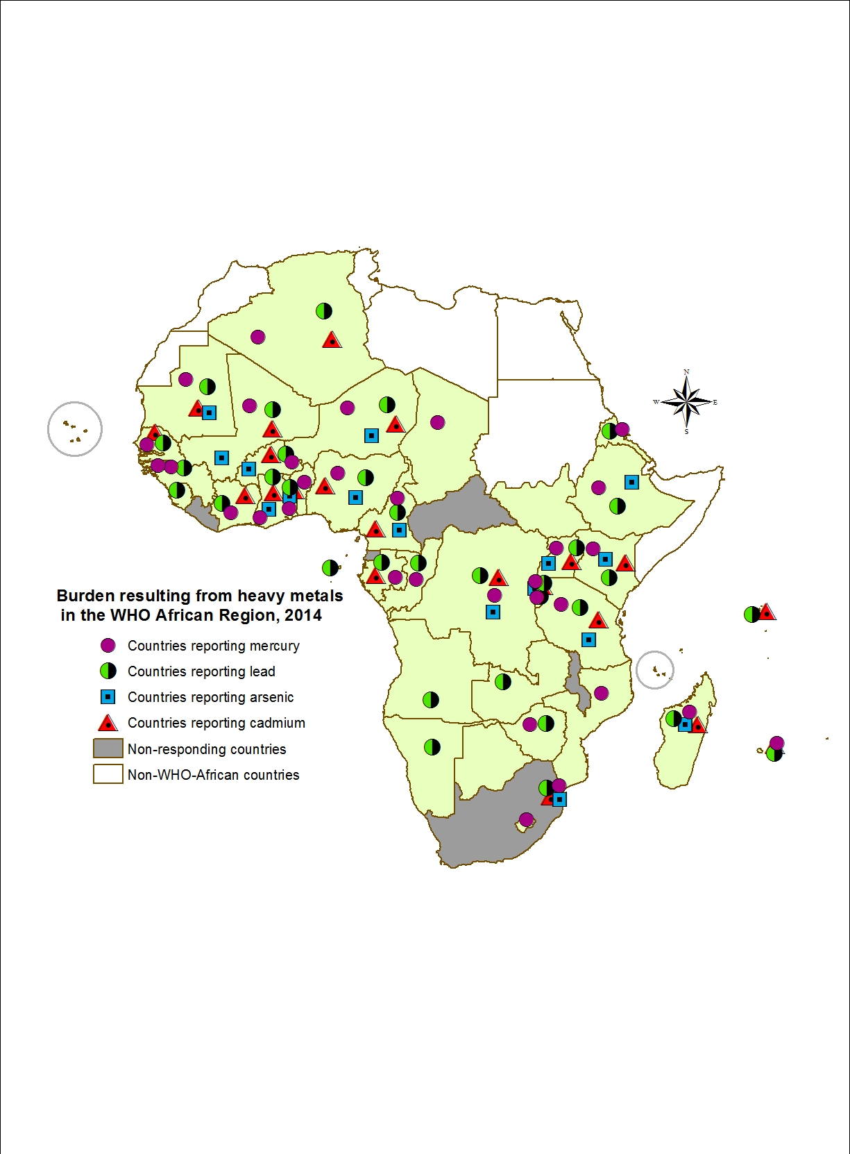
The Problem
To prevent chemicals from becoming a burden for countries, there needs to be a control system to avoid harm and promote the use of safe chemicals.
This is why we need
chemicals governance.
https://www.afro.who.int/publications/chemicals-public-health-concern-african-region-and-their-management-regional
Notes:
https://www.afro.who.int/publications/chemicals-public-health-concern-african-region-and-their-management-regional

Slide 4
The general objective of chemicals governance is
ensuring the protection of people’s health and the environment by establishing rules to prevent and minimize the harmful impacts of chemicals.
By controlling chemicals, States also support innovation of safe chemicals, and ensure the same rules for companies.

Slide 5
To start:
Governments already have obligations to manage chemicals & waste, in:
Chemicals and Waste Treaties,
Human Rights Law,
International Environmental Law,
Constitutions and National Laws, etc.
The 2030 Agenda and SAICM also set chemicals-related goals and targets.

Slide 6
Chemicals Governance
Made Simple
The Key Functions we will cover include:
Market Placement and “Chemicals Control”
Manufacturing, Distribution, and Use
End of Life
But the prerequisite to effective chemicals governance is the creation of administrative & financial infrastructure to govern the placement and management of chemicals in the market.

Slide 7
Infrastructure
States need to:
Create or strengthen the administrative infrastructure, and
Create or strengthen government institutions and establish clearly defined responsibilities for each entity.
Those institutions need human and financial resources.

Slide 8
Infrastructure: How to Start
Which are the legal and institutional infrastructures governing the placement of chemicals on the market, and how can we strengthen them?
We need to:
Evaluate the gaps and needs of the country with regard to the legal and institutional infrastructures governing the placement of chemicals on the market, and
Identify and assess possible options to fill in the gaps.
Outputs of our evaluation will be:
An overview of the existing legal and institutional infrastructures, implementation and enforcement, and financing mechanisms, and
A draft baseline and proposed steps to strengthen the system.

Slide 9
Main Considerations for the Development of Institutional Proposals
Administrations are typically organized at 3 levels: Policy, Management, and Enforcement.
Is it better to reform the existing bodies or to create new entities?
We should decide on:
Coordination and cooperation mechanisms to establish, which can be both internal (within the institution) and external (with other institutions and stakeholders);
Information management systems, including monitoring and surveillance of chemicals in the country; and
Human and technical capacity, which requires sharing information, technologies, and capacity building.

Slide 10
1. Market Placement and “Chemicals Control”
We should decide what chemicals are introduced into our society and how they are introduced.
“Chemicals control” refers to the upstream regulation of industrial and consumer chemicals,
before and when placed on the market in a country.
For example, States:
Ban the most hazardous chemicals
Restrict (approve but limit) the uses of certain chemicals
UNEP, Information document (role and benefits of chemicals control)

Slide 11
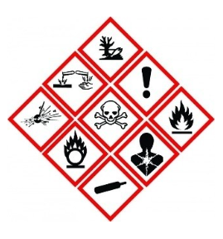
What do we need to know to “control” chemicals upstream?
Making these decisions requires reliable information about the hazards/risks associated with those chemicals.
Some of this information may be available through existing databases such as REACH, OECD eCHEM, UN GHS list of CMR substances…
But much resides with chemicals companies. States can thus set legal requirements to turn this information over, and share it across the chemicals lifecycle.

Slide 12
2. Manufacturing, Distribution, and Use
Once chemicals are produced, industry and States need to
Ensure proper labelling/information dissemination on the substances, including for the permissible uses of restricted chemicals;
Meet treaty and other obligations;
Have systems to monitor the extent to which chemicals are reaching the relevant populations (starting with human) and, to be proactive, the “channels” by which they get there, e.g., via food, water, consumer products, etc.; and
Run controls (inspections, enforcement) to ensure safe production and use of chemicals.

Slide 13
3. End of Life
For a safe ending, we need:
A waste management infrastructure,
A system to clean up toxic legacies from before these laws were introduced, ideally following the polluter-pays principle.

Slide 14
The Benefits
The benefits of chemicals control include:
Reducing pollution,
Preventing health harm to current and future generations,
Increasing the impact of other cross-cutting legislation (e.g., workers’ protection, emissions from production, human rights, etc.), and more!
UNEP, Information document (role and benefits of chemicals control)

Slide 15
Some Useful Resources
Chemical Observatory, Africa https://chemobsafrica.org/about/
IOMC Toolbox for Decision Making in Chemicals Management
UNEP Guidance on Chemicals Control

